Slide 1
CS209a
Final Project
An Inquiry on Taste for Future Coffee World Domination
Notes:
Kuki

Slide 2
Our team
Helen Zhao
Alexandra Ramassamy
Kushagra Chitkara
Katherine Hunter
Alyssa Chang
Notes:
kuki

Slide 3
Project stages
EDA
Other feature importance methods
Problem Statement
Baseline and first analysis
Notes:
kuki

Slide 4
01
Problem Statement
Notes:
kuki

Slide 5

Coffee Quality Institute
The Coffee Quality Institute provides coffee evaluations using tasting experts who score the coffees based on features such as acidity, body, and balance... and one subjective Cupper Points.
We set out to determine what features cause a coffee to receive a higher rating, and whether other variables like coffee origin contribute.
Notes:
kuki

Slide 6
Which features mostly impact our appreciation of the taste of coffee (the general grade given to a coffee)?
Notes:
kuki

Slide 7
02
Visualization/EDA/Analysis
Notes:
Katherine

Slide 8
The dataset
Merge of 2 datasets : Robusta beans and Arabica beans
Initially 44 columns (~½ numerical)
Preprocessing needed for some categorical (Altitude, Harvest Year, Bag Weight…)
Many outliers and low variance for some variables
Some class imbalances : Country, Specie,...
Notes:
Katherine

Slide 9
Main features
Coffee quality
Aroma
Flavor
Aftertaste
Acidity
Body
Balance
Location:
Country of Origin
Altitude
Packaging info
Bag Weight
Expiration Year
Defects
Category One Defects
Category Two Defects
Notes:
Katherine

Slide 10
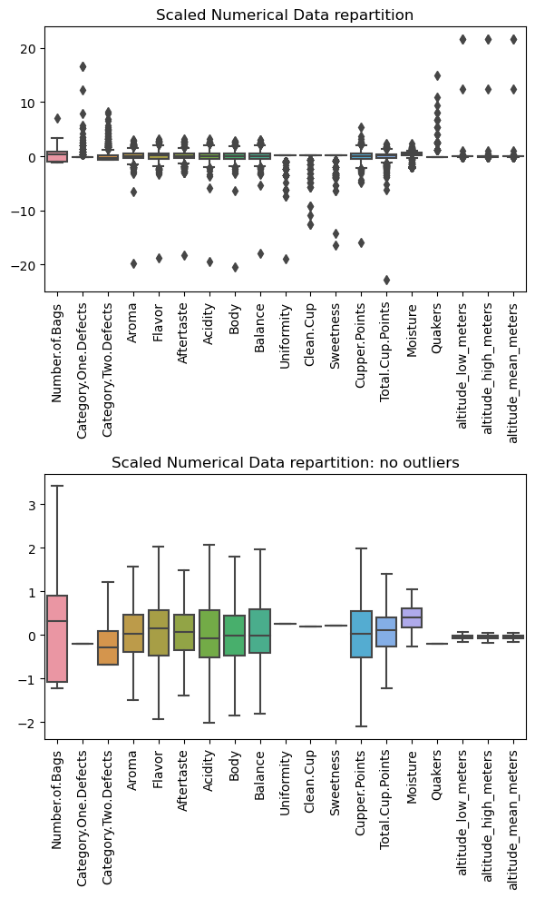
Numerical Features
The original dataset includes extreme outliers, we removed outliers and scaled numerical features.
The scaled scores, such as Total.Cup.Points, Aroma, ect are approximately symmetric around the mean.
Some features, such as Uniformity, Clean.Cup, Sweetness have very low variance.
Notes:
Katherine

Slide 11
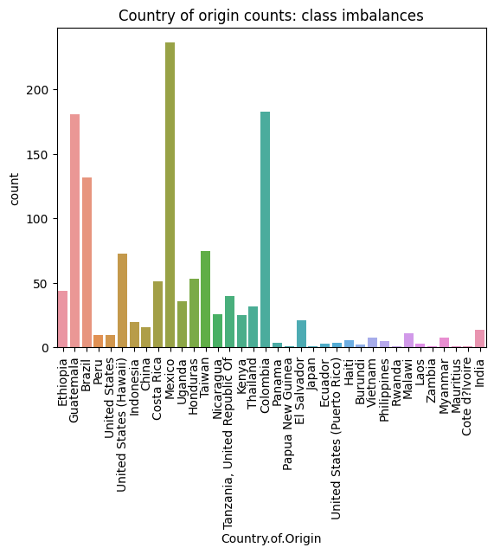
Country of origin
Due to the class imbalances, we decided to reduce the Country of Origin categories to:
Mexico
Colombia
Guatemala
Brazil
Taiwan
United States (Hawaii)
Other
Notes:
Katherine

Slide 12
03
Baseline Model
Notes:
Alexandra

Slide 13
Baseline preprocessing
01
02
03
04
05
Drop
Clean
One-hot encode
irrelevant features
numeric features
categorical features
Impute
Scale
missing values using the mean
numeric features
Notes:
Alexandra

Slide 14
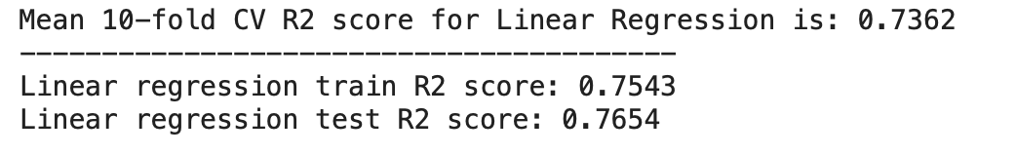
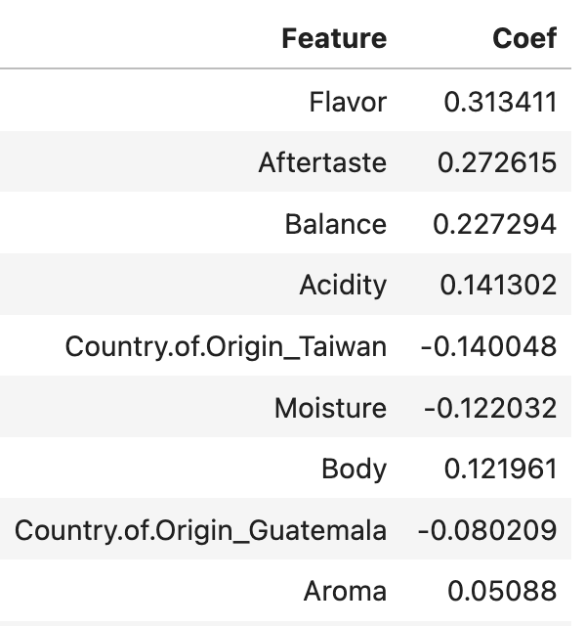
Baseline - Linear Regression - Model
Notes:
Alexandra

Slide 15
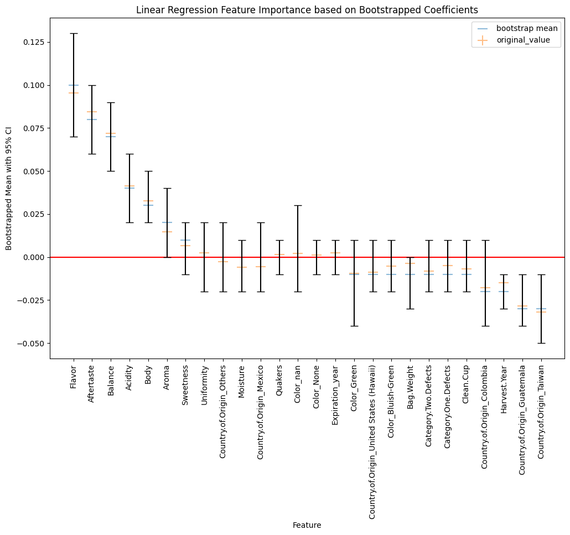
Baseline - Linear Regression + Bootstraps - Interpretation
The previous graph allows us to better understand the actual importance of each feature while predicting a coffee general grade.
By looking at it, we can see that only 10 features have an actually meaningful impact and the most important ones are:
Flavor (positive effect)
Aftertaste (positive effect)
Balance (positive effect)
Acidity (positive effect)
Body (positive effect)
Aroma (positive effect)
Bag_Weight (negative_affect)
Harvest_Year (negative_affect)
Guatemala (negative_affect)
Taiwan (negative_affect)
Notes:
Alexandra

Slide 16
04
Other Feature Importance methods
Notes:
Kuki

Slide 17
Lasso Regression
Notes:
kuki

Slide 18
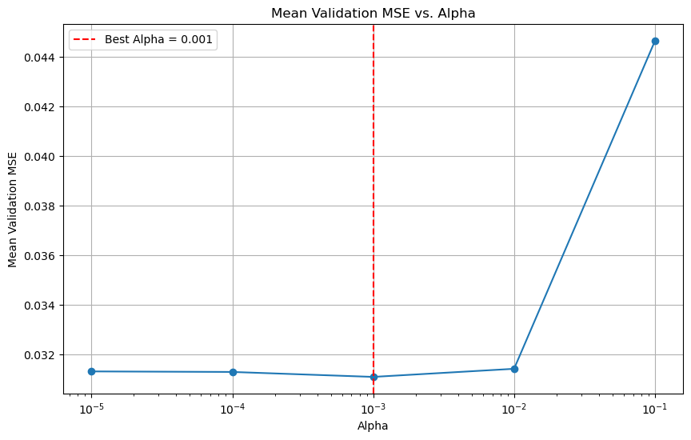
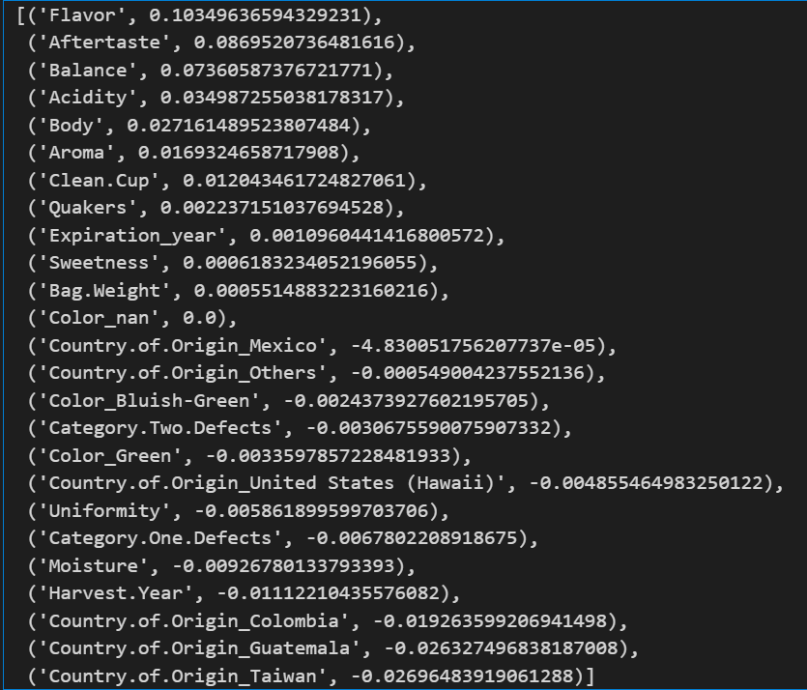
Lasso Regression - Choice of lambda
Notes:
kuki

Slide 19
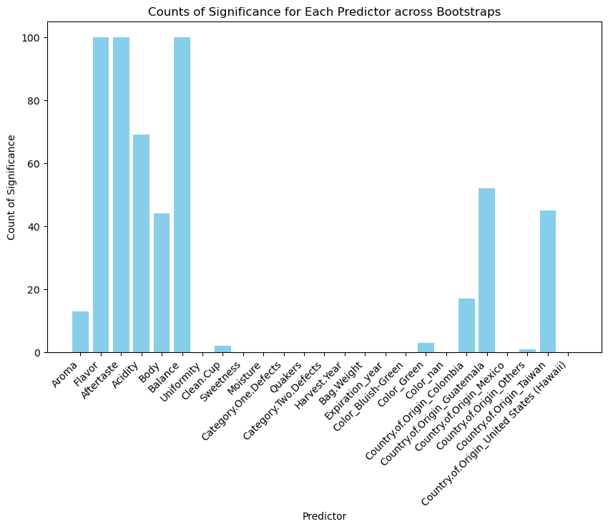
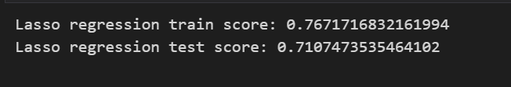
Lasso Regression - Results
Important Features
Balance
Acidity
Aftertaste
Flavor
Aroma
Body
Notes:
kuki

Slide 20
Mean Decrease In Impurity
Notes:
Helen

Slide 21

Random Forest
We used grid search to tune the hyperparameters n_estimators and max_depth for our Random Forest model on the training data. The default criterion of "squared error" was used to evaluate our random forest.
Training Details:
Time taken for grid search: 3 minutes
Best Model Details:
Max_depth = 9
N_estimators = 100
MSE score: 0.7218
Notes:
Helen

Slide 22
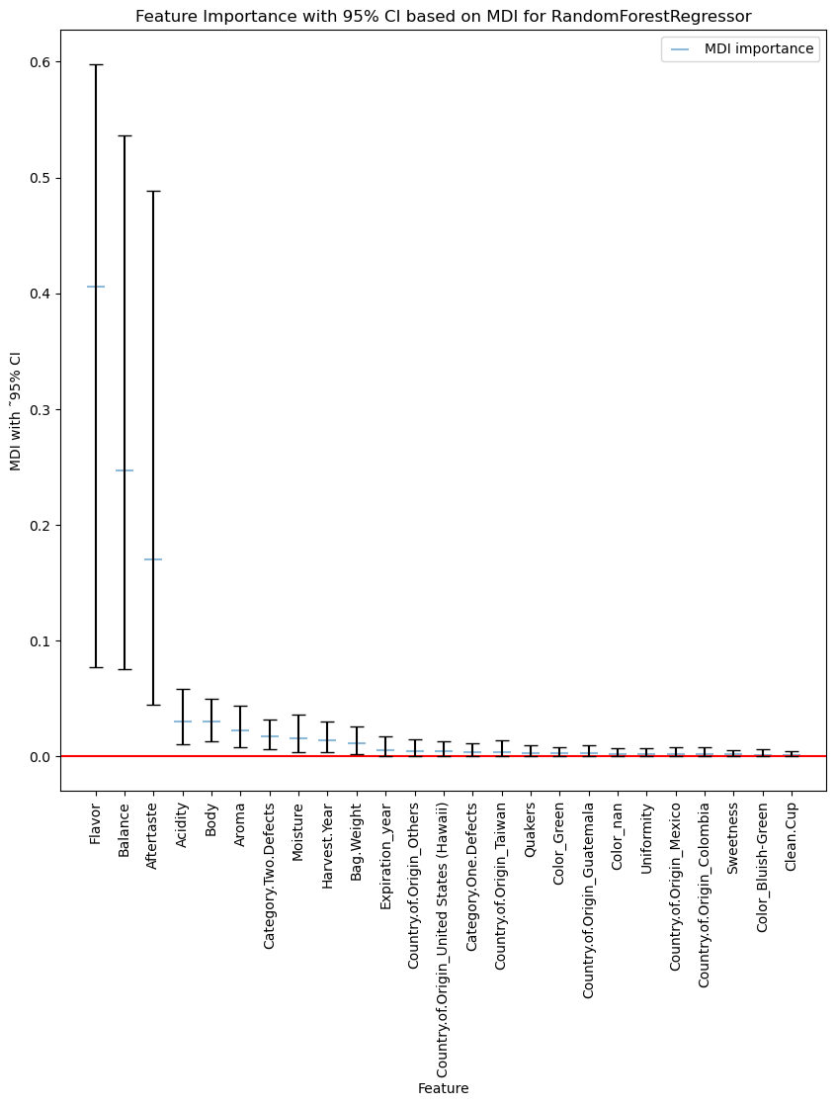
MDI -Random Forest
After plotting the feature importance on Mean Decrease in Impurity, there are 9 features that seem to be important:
- Flavor - Balance - Aftertaste | - Acidity - Body - Aroma | - Category.Two.Defects - Moisture - Harvest.Year
These features closely match, but not exactly, the features found previously with the linear Regression.
On the other hand, Guatemala and Taiwan doesn't seem to be considered as significant in our Random Forest model even though the feature importance plot previously (for linear regression) suggested that they might be.
The green features overlaps the one from the baseline and might actually be significant in the evaluation of coffee.
Notes:
Helen

Slide 23

Bagging
We used grid search to tune the hyperparameter n_estimators for our Bagging model on the training data. The default criterion of "squared error" was used to evaluate our random forest.
Training Details:
Time taken for gridsearch : 3 minutes
Best Model Details:
N_estimators = 500
MSE score: 0.7214
Notes:
Alexandra

Slide 24
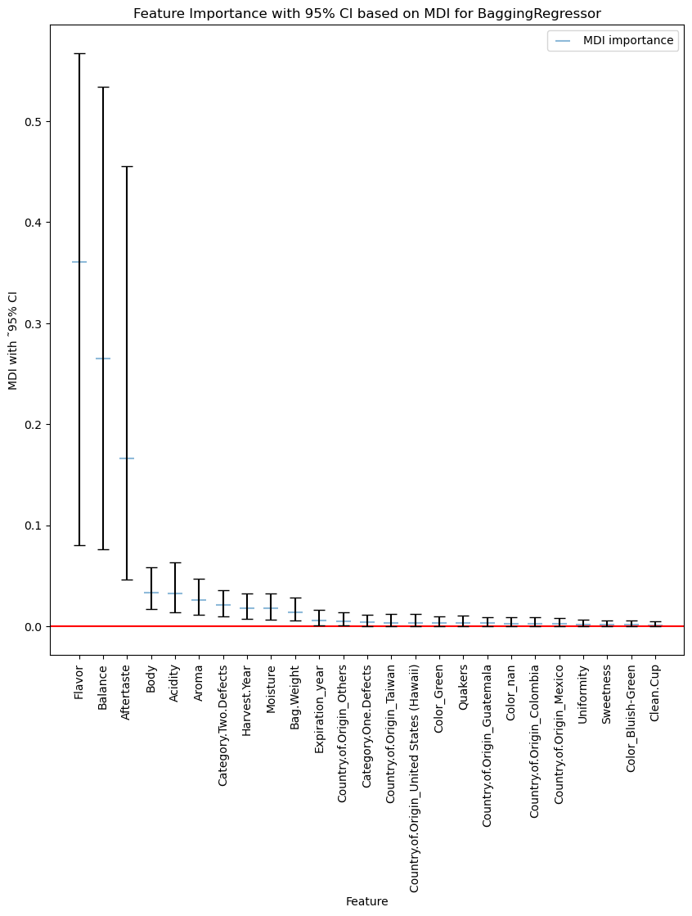
MDI - Bagging
The above feature importance plot for bagging once again shows similar results as the random forest and linear regression model feature importances. Specifically, the above plot shows that there are 10 important features:
- Flavor - Balance - Aftertaste | - Acidity - Body - Aroma | - Category.Two.Defects - Moisture - Harvest.Year - Bag.Weight
The features chosen by the random forest model have all also been chosen as important for bagging, the only difference is that bagging also includes Bag.Weight.
The green features overlap the one from the baseline and might actually be very significant in the evaluation of coffee.
Notes:
Alexandra

Slide 25
Permutation Importance
Notes:
Katherine

Slide 26
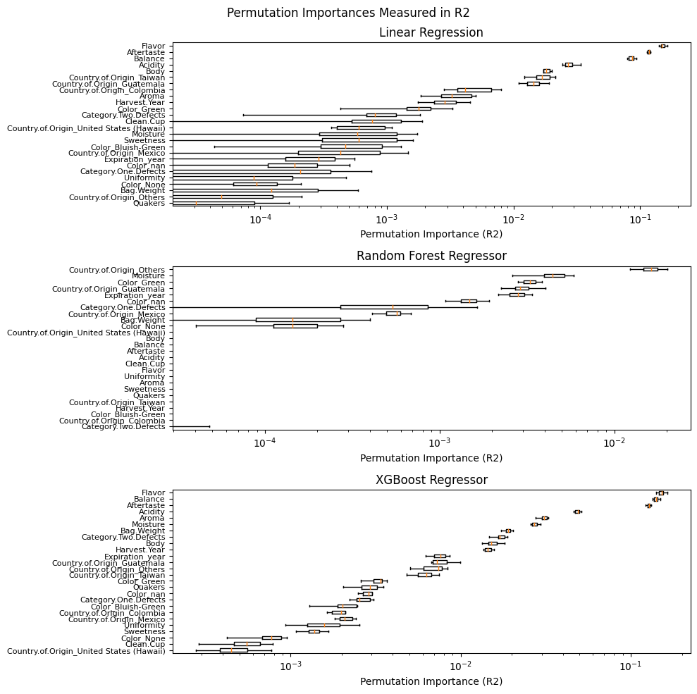
Permutation Importance: Linear Reg
ΔR2: ~ 0.1
ΔR2: Between 0.01 and 0.1
Notes:
Katherine

Slide 27
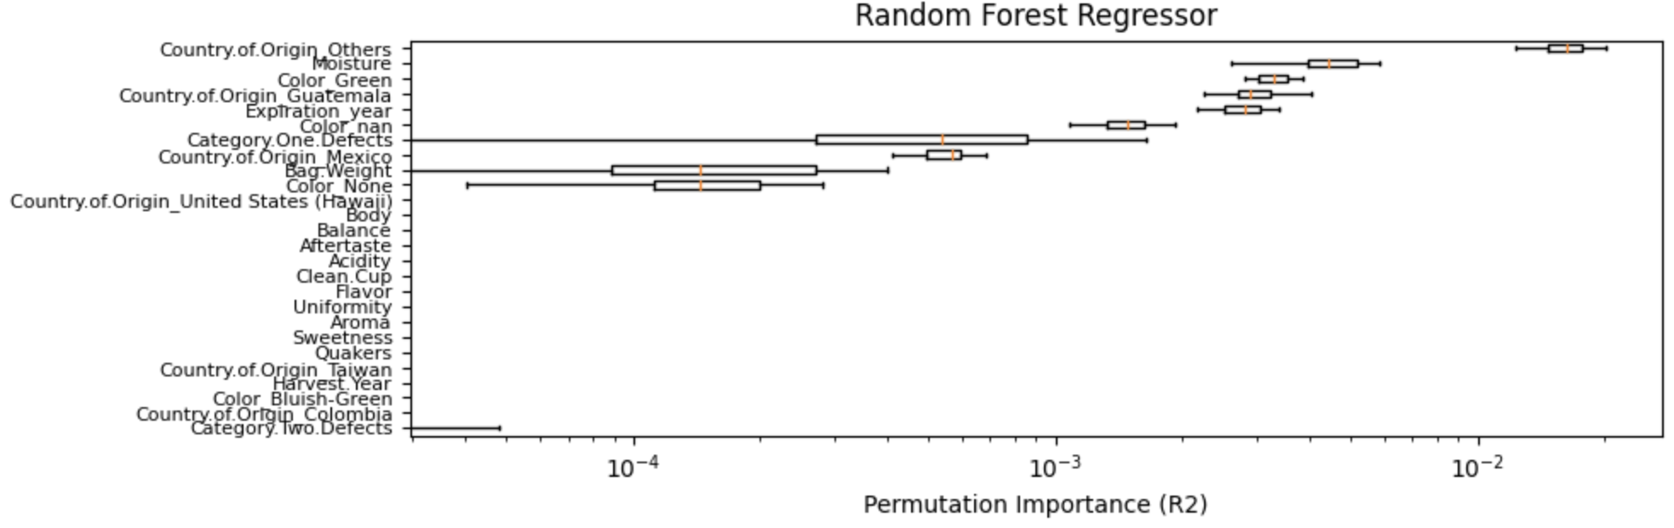
Permutation Importance: Random Forest
All have very low importance: reflective of random forest algorithm
Notes:
Katherine

Slide 28
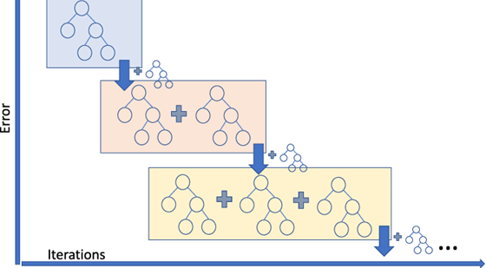
XGBoostRegressor
XGBoost:
Gradient Boosting Algorithm
Training Details:
Max_depth = 3
N_estimators = 50
Learning rate = 0.1
Colsample_bytree = 0.3
Alpha = 0
Mean 10-fold CV R2 score : 0.73
Test score: 0.762
https://medium.com/analytics-vidhya/what-is-gradient-boosting-how-is-it-different-from-ada-boost-296f055ecacd
Notes:
Katherine

Slide 29
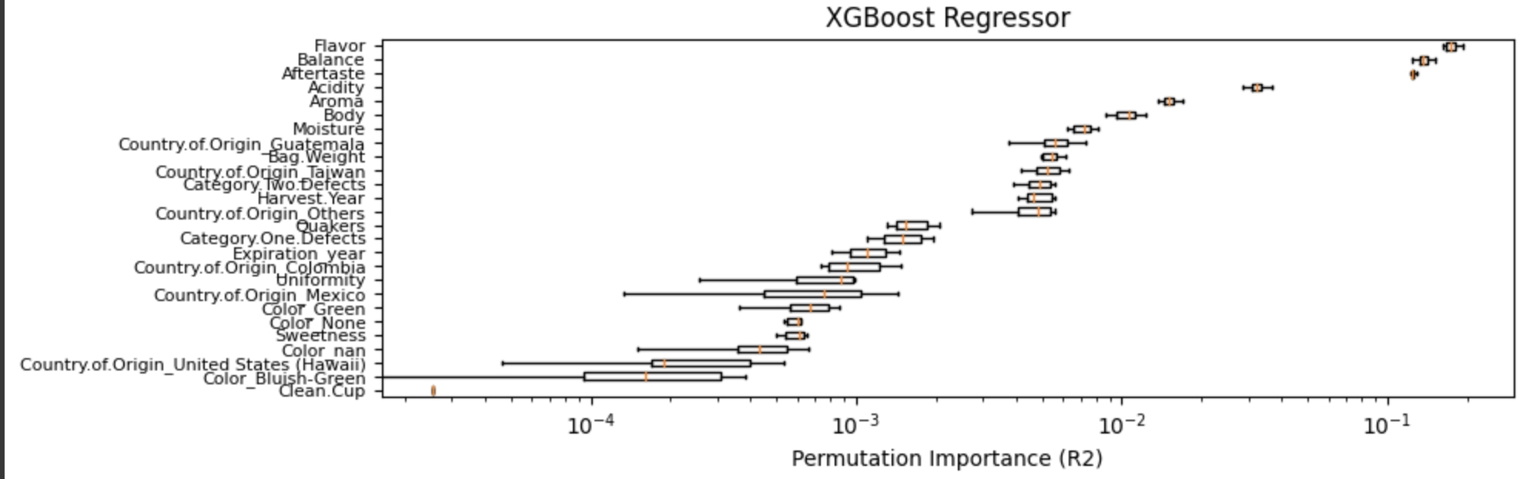
Permutation Importance: XGBoost
Agrees with linear regression on most important features
Lower variance than LR
Notes:
Katherine

Slide 30
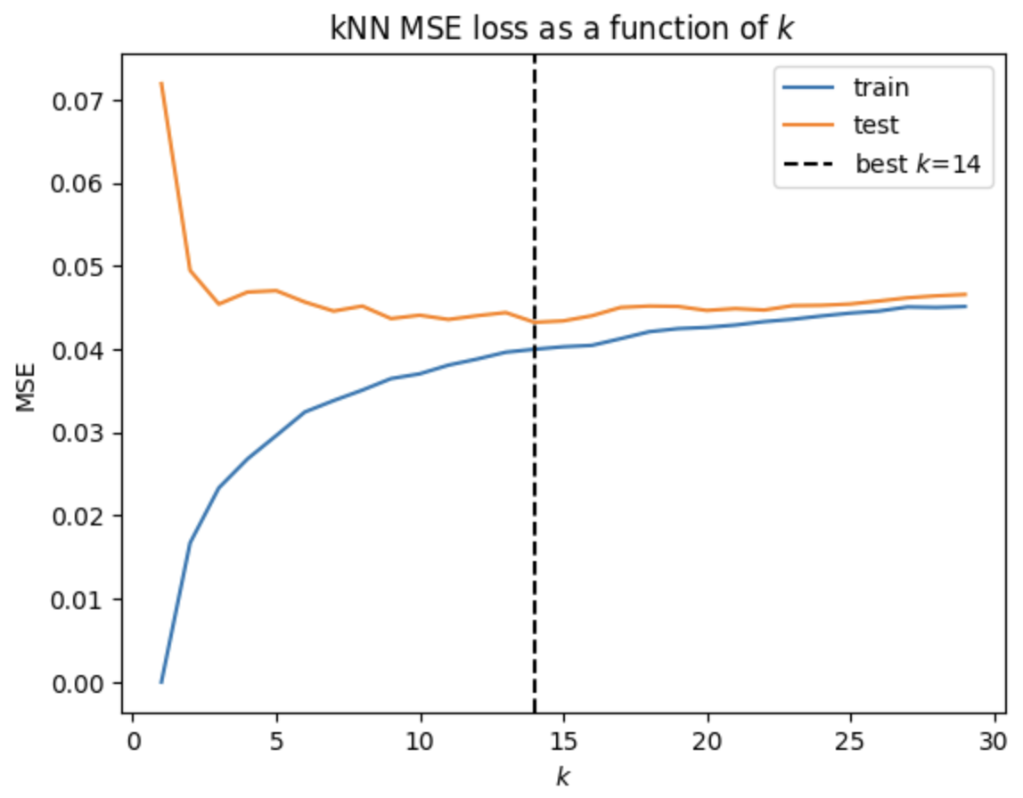
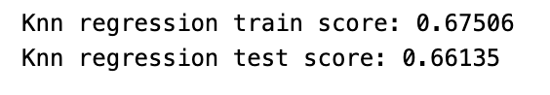
KNN Regression
We use cross validation to determine the best k and run KNN regression to predict Total.Cup.Point.
The model gets a lower score than the baseline model on both training and test set.
Notes:
Alyssa
we also tried KNN regression. We went through cross-validation to determine the best parameter k. This model didn't outperform our baseline. But it still showed some predictive power, and that's why we decded to add it into the mix for our stacking model.

Slide 31
Stacking
Notes:
Alyssa

Slide 32
Stacking - model and performance
stacking previous individual estimators and use a simple linear regression to compute the final prediction.
Parameters:
estimators: linear regression, knn regression, lasso regression, random forest, xgboost
final_estimator: LinearRegression()
cv=5
Scores:
training score: 0.80207
test score: 0.78041
Notes:
Alyssa
And finally we created the stacking ensemble! We combined all the previous models, and for our final estimator, we went with a straightforward linear regression model. We used 5-fold cross-validation to fine-tune things.The stacking model gives us the highest scores in both the training and test datasets.

Slide 33
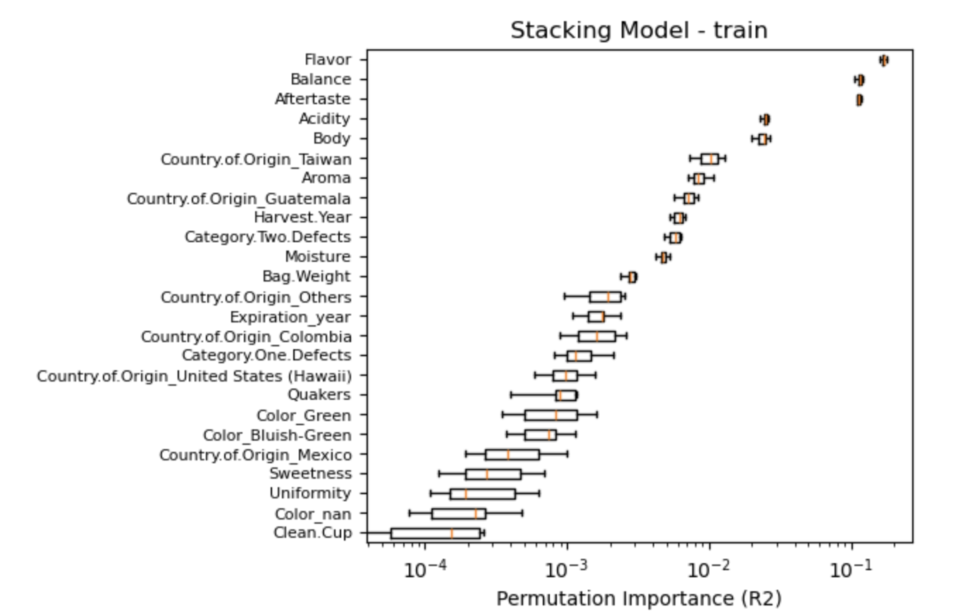
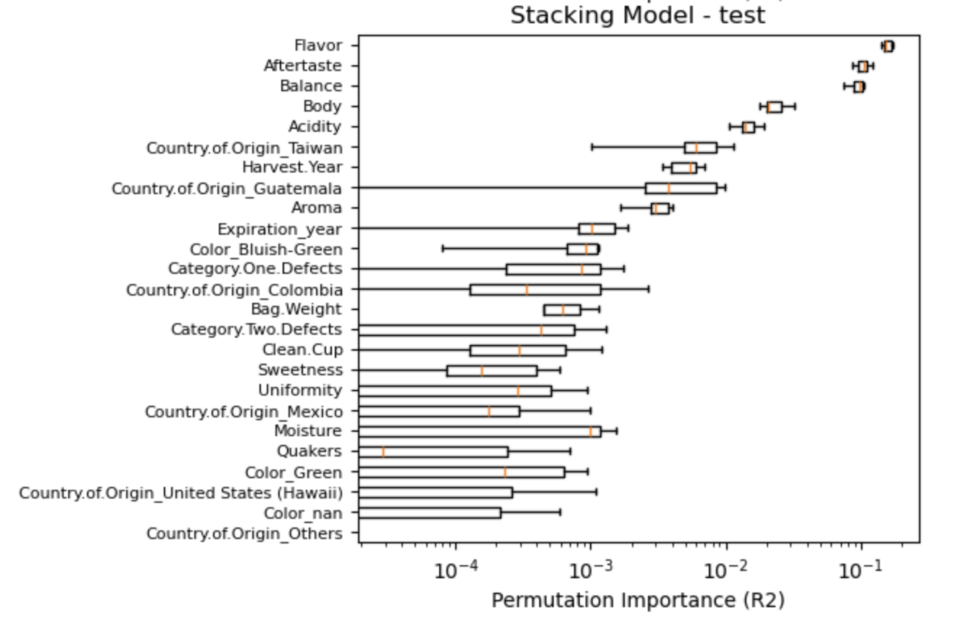
Stacking - feature importance
Similar to individual models, we consistently find Flavor, Balance, and Aftertaste are the most important predictors in the training process (R2 decreases by around 0.1 after permuting those predictors), they also contribute most to test score.
Notes:
Alyssa

Slide 34
05
Conclusion
Notes:
Helen

Slide 35
Feature Importance - Conclusion
After plotting feature importances from three different models: Linear Regression, LASSO, Random Forest, XGBoost Regressor, and stacking, we were able to identify which ones were more importance than others:
Most important features:
Medium important features:
Flavor
Balance
Aftertaste
Acidity
Aroma
Body
All our models R^2 scores were between 0.7 and 0.8.
Notes:
Helen

Slide 36
06
Future Work
Notes:
Alyssa

Slide 37
Future Work
Transform into Classification problem - good vs bad coffee
Find other data to evaluate coffee without expert (price as response variable)
Notes:
Alyssa
Firstly, we are thinking about discretizing all the score measures. Usually people ask “Is the coffee good or bad?" It seems people are more interested in that than the exact scores. We figure a model that gives us general info instead of precise scores might align better with user preferences.
Furthermore, we're pretty excited about trying out the stacking model, which is doing a good job in both training and test datasets. Our plan is to use it on coffee shops around Harvard Square, getting input through some quick questionnaires. We're hoping this will help us figure out which coffee comes out on top according to our model.
However, As we're diving into this, we realized a generalizability concern. The current response variable relies on scores given by experts, which may differ from those of the general public. So, we're having the idea of improvement. Instead of expert scores, we want to further collect data about the price of each coffee bean and use it as response variable (the data collection process could be hard). And it makes sense that good coffee tends to cost a bit more. This adjustment should make our model more solid and reliable.

Slide 38
Thanks!
CS209a
Notes:
Alyssa

Slide 39
Feature Importance - MDI vs PI
The effect of other features on the total cup points is marginal. This is consistent with the features identified as important according to MDI. However, permutation importance reveals an even more distinct difference in feature importance between flavor, balance, and aftertaste and the other features as compared with the MDI.
As expected, the features related to country of origin are more important to the total cup points than the MDI would indicate, and we know from the simple linear regression coefficients that coffee from Taiwan, Guatemala, and Colombia are related to a decrease in the total cup points.
Notes:
Helen

Slide 40
Background of the project: CGI
Do you know what helps you make your point clear? Lists like this one:
They’re simple
You can organize your ideas clearly
You’ll never forget to buy milk!
And the most important thing: the audience won’t miss the point of your presentation

Slide 41
Table of contents
01
02
03
04
05
06
The project
Requirements
Project goals
You can describe the topic of the section here
You can describe the topic of the section here
You can describe the topic of the section here
Sneak peek
Project stages
Our team
You can describe the topic of the section here
You can describe the topic of the section here
You can describe the topic of the section here

Slide 42
Contents of this template
You can delete this slide when you’re done editing the presentation
Fonts | To view this template correctly in PowerPoint, download and install the fonts we used
Used and alternative resources | An assortment of graphic resources that are suitable for use in this presentation
Thanks slide | You must keep it so that proper credits for our design are given
Colors | All the colors used in this presentation
Icons and infographic resources | These can be used in the template, and their size and color can be edited
Editable presentation theme | You can edit the master slides easily. For more info, click here
For more info: SLIDESGO | SLIDESGO SCHOOL | FAQs
You can visit our sister projects: FREEPIK | FLATICON | STORYSET | WEPIK | VIDEVO

Slide 43
Our company
Mercury is the closest planet to the Sun and the smallest one in the Solar System—it’s only a bit larger than the Moon. The planet’s name has nothing to do with the liquid metal, since Mercury was named after the Roman messenger god

Slide 44
What we are working on
Accessibility
Bigger menu
Comfort
Despite being red, Mars is actually a cold place
Jupiter is the biggest planet in the Solar System
Saturn is composed mostly of hydrogen and helium

Slide 45

A picture is worth a thousand words

Slide 46
About the project
Mercury is the closest planet to the Sun and the smallest one in the Solar System—it’s only a bit larger than the Moon. The planet’s name has nothing to do with the liquid metal, since Mercury was named after the Roman messenger god

Slide 47
—Someone Famous
“This is a quote, words full of wisdom that someone important said and can make the reader get inspired.”

Slide 48

A picture always reinforces the concept
Images reveal large amounts of data, so remember: use an image instead of a long text. Your audience will appreciate it

Slide 49
Now
Venus has a beautiful name and is the second planet from the Sun. It’s terribly hot—even hotter than Mercury—and its atmosphere is extremely poisonous. It’s the second-brightest natural object in the night sky after the Moon

Slide 50
Future
Venus has a beautiful name and is the second planet from the Sun. It’s terribly hot—even hotter than Mercury—and its atmosphere is extremely poisonous. It’s the second-brightest natural object in the night sky after the Moon

Slide 51
Awesome words

Slide 52
Project goals
Goal 1
Goal 2
Mercury is the closest planet to the Sun
Saturn is composed of hydrogen and helium
Goal 3
Goal 4
Neptune is the farthest planet from the Sun
Despite being red, Mars is a very cold place

Slide 53
Major requirements
01
02
Mercury
Venus
Mercury is the closest planet to the Sun and the smallest one in the Solar System
Venus has a beautiful name, but also extremely high temperatures

Slide 54
Budget
$150,000
Total budget of the project
50%
20%
35%
Earth
Neptune
Mars
It’s the third planet from the Sun
It’s the farthest planet from the Sun
Despite being red, Mars is a cold place

Slide 55
Our target customers
Gender
45%
20%
35%
Age
26 - 35
50%
36 - 45
65%
46 - 55
30%

Slide 56
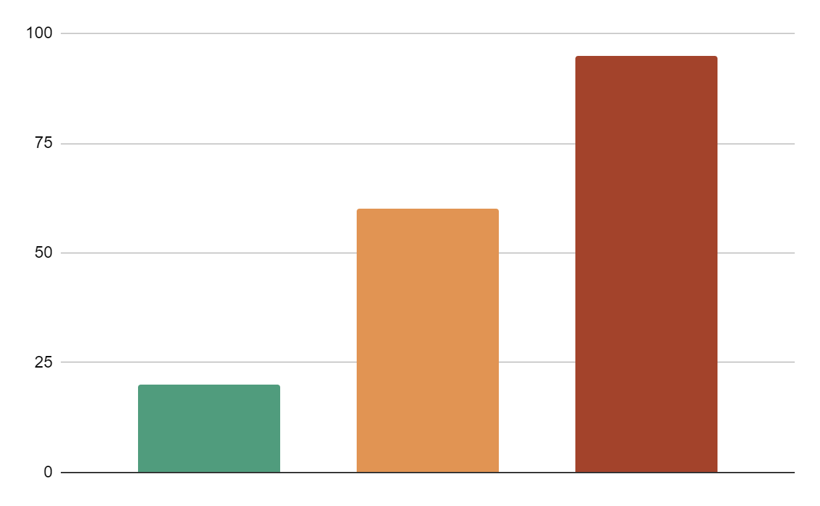
Predicted results
Mercury
Mercury is the closest planet to the Sun
20%
Mars
Despite being red, Mars is a cold place
60%
Saturn
Saturn is composed of hydrogen and helium
95%
Follow the link in the graph to modify its data and then paste the new one here. For more info, click here

Slide 57

Come visit us!
Mercury is the closest planet to the Sun and the smallest one in the Solar System—it’s only a bit larger than the Moon. The planet’s name has nothing to do with the liquid metal, since Mercury was named after the Roman messenger god

Slide 58

Sneak peek
You can replace the image on the screen with your own work. Just right-click on it and select “Replace image”

Slide 59
Our special services
 | Cafe | Books | Others
Monday | Mars | Moon | Jupiter
Wednesday | Mercury | Earth | Saturn
Friday | Venus | Sun | Neptune

Slide 60
Project stages
Step 01
Step 02
Step 03
Step 04
Jupiter is the biggest planet in the Solar System
Mercury is the smallest planet in the Solar System
Earth is the third planet from the Sun and has life
Despite being red, Mars is actually a very cold place

Slide 61
Things to keep in mind
Mercury
Venus
Mars
Mercury is the closest planet to the Sun
Venus is the second planet from the Sun
Despite being red, Mars is a very cold place
Jupiter
Saturn
Neptune
Jupiter is the biggest planet of them all
It’s composed of hydrogen and helium
Neptune is the farthest planet from the Sun

Slide 62
Cafe bookstores around the world
Mercury
Mercury is the closest planet to the Sun
Mars
Despite being red, Mars is a cold place
Jupiter
It’s the biggest planet in the Solar System

Slide 63
Our partners
Mercury
Venus
Mars
Mercury is the closest planet to the Sun and the smallest one in the Solar System—it’s only a bit larger than the Moon
Venus has a beautiful name and is the second planet from the Sun. It’s terribly hot—even hotter than Mercury
Despite being red, Mars is actually a cold place. The planet is full of iron oxide dust, which gives the planet its reddish cast

Slide 65


Our team
Elena Jones
Anna Doe
You can replace the image on the screen with your own
You can replace the image on the screen with your own

Slide 66
10,000,000
Big numbers catch your audience’s attention

Slide 67
Thanks!

Slide 68
Alternative resources
Here’s an assortment of alternative resources whose style fits that of this template:
Vectors
Naive coffee stickers set
World book day vertical poster template

